Slide 1
Lecture 13 October 2,2019
Lab 4-–analysis of corn data—linked to website. Be sure to bring your data with you! (One 1pm group needs to enter data on the Swain computer, if possible).
You should know most of what you need to do after today’s lecture!

Slide 2
Where were we?....
Multi-factor crosses
Product rule for combining probabilities for traits
Using forked-line/branch diagrams to replace Punnet squares (and using product rule within)

Slide 3
Test yourself!
In a 5-point cross, what ratio of F2 offspring should show all dominant traits?
All recessive traits?
This genotype? AAbbCcDDEe—What is the probability that the F2 offspring will have this genotype? (Go back to the 1:2:1 genotype ratio)

Slide 4
Let’s return to probabilities…
Mendel’s observations allow us to predict the outcome of other experiments
Cross of violet (dominant) X white (recessive) flowering plants
F1? 100% violet flowering plants
What would you predict to find in F2 plants?

Slide 5
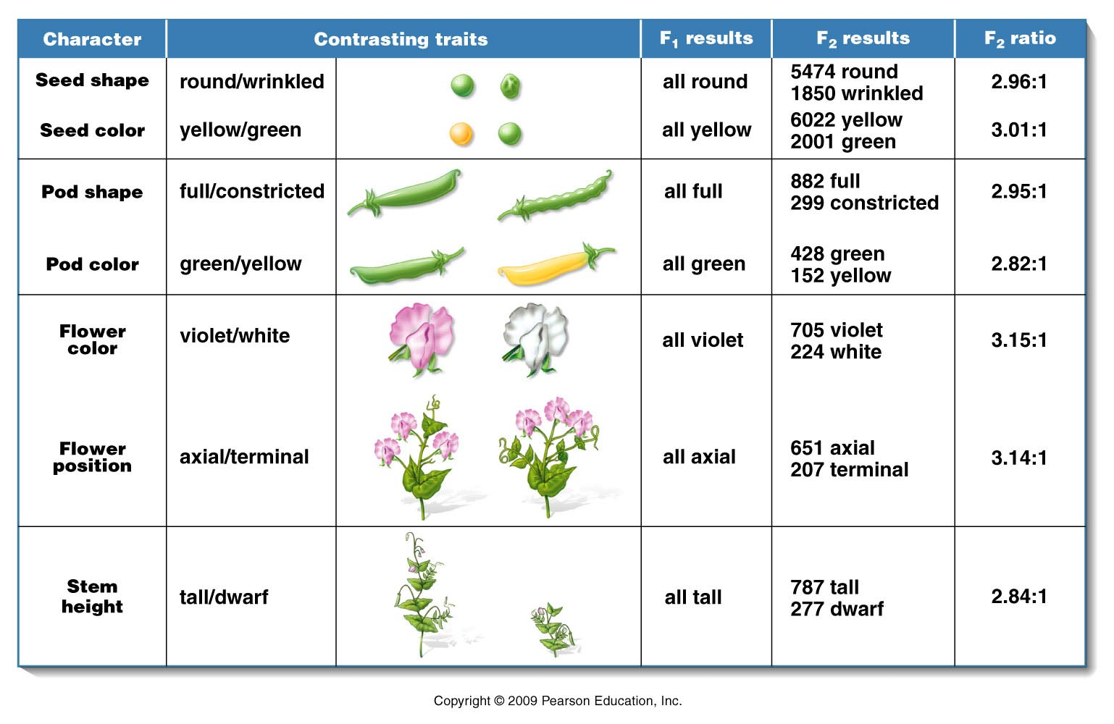
F2 prediction/probabilities?
¾ violet: ¼ white
Mendel observed 929 plants: 705 violet/224 white

Slide 6
What did you expect theoretically?
¾ (929) violet=696.75
¼ (929) white=232.25
…Why this deviation/difference from the expected:
705 violet/224 white?
…Is it reasonable deviation?

Slide 7
First…where could the deviation come from?
F2 offspring were the product of:
1. gamete formation (random alignment of homologs at metphase I)
2. random union of gametes
Is there any opportunity for chance to alter expected outcomes here?...

Slide 8
The 13 Scwandt children---ages 2-25.

Slide 9
Biology is full of random fluctuations/chance deviation
Can use statistical tests to evaluate whether data fits an expectation by evaluating the influence of chance on the data.
One such test called the Chi-Square test
Like all statistical tests, it allows us to test a general statement called the Null Hypothesis (H₀)

Slide 10
Null Hypothesis (H₀)
“There is no real difference between the measured values/ratio etc. and the expected values/ratio etc. Any apparent difference can be attributed to chance alone.”
Memorize and understand this!

Slide 11
It’s the ultimate humble hypothesis!
Scientists/analysts don’t want to be mislead. By starting with the possibility of “just chance” as an explanation/hypothesis, they don’t waste time pursuing data that doesn’t quite fit expectations.
But when statistics tell us to reject this hypothesis, we may have something new to discover/explain.

Slide 12
Chi-square
Chi-square (X²) analysis helps us decide whether deviation in expected and observed values are reasonably attributed to chance.
Or…if the deviation is so great that the reason is something more interesting than chance.

Slide 13
In X² analysis, one of two results are possible.
Reject the null hypothesis
Indicates the deviation in expected and observed values is too great to be attributed to chance alone (look for alternative explanations)
2. Fail to reject the null hypothesis
Indicates the deviation in expected and observed values can reasonably be attributed to chance alone. If you have an expected outcome, your data shows reasonable difference from theoretical outcomes.

Slide 14
X² analysis
X²= Ε (o-e)²
e
X²= the sum of the difference of observed and expected values, squared, divided by the expected value.
Let’s plug in Mendel’s data from the Tall X dwarf cross on the board (figure 3.1)

Slide 15
Figure 3.1
Notes:
Figure 3-1 A summary of the seven pairs of contrasting traits and the results of Mendel’s seven monohybrid crosses of the garden pea (Pisum sativum). In each case, pollen derived from plants exhibiting one trait was used to fertilize the ova of plants exhibiting the other trait. In the F¹ generation, one of the two traits (dominant) was exhibited by all plants. The contrasting trait (recessive) then reappeared in approximately one-fourth of the F² plants.

Slide 16
X²⁼ Tall (0.15) + dwarf (0.45) = 0.60
X²⁼ 0.60

Slide 17
Next step…
Determine the degrees of freedom for you data. (How many categories can contribute to the deviation in the observed and expected values?).
df= n-1, where n is the number of categories you have analyzed. In our example monohybrid crosses give 2 kinds of offspring (tall and dwarf) n=2 ; df=1

Slide 18
Next step…
Determine a probability (p value) from a graph or table.
X² values in blue area
P-values (range) at top
df on left side

Slide 19
What does a p value mean?
A p-value is the probability that we would see as much, or more difference in observed and expected values due to chance alone--- in repeated experiments.
e.g. p=0.90 (high p-value) ---in repeated experiments we could expect this much, or more deviation in observed and expected values 90% of the time due to chance alone…
p= 0.01 (low p-value) in repeated experiments we could expect this much, or more deviation in observed and expected values 1% of the time due to chance alone…

Slide 20
In statistics, we often use an arbitrary probability cut-off of 0.05 to decide whether to reject H₀
P< 0.05 means that the observed deviation in observed and expected results would happen less than 5% of the time by chance alone.
In this case we would reject H₀
p>0.05 means that the observed deviation in observed and expected results would happen at least 5% (5% or more) of the time by chance alone.
In this case we would fail to reject H₀

Slide 21
It’s a pretty humble cutoff…
When we reject H₀ we say the data shows a large enough deviation to consider an alternative explanation. (not chance deviation)
When we fail to reject H₀ we say that the deviation in the data can reasonably be attributed to chance.

Slide 22
Practice!!
Try chi-square analysis on any/all of the monohybrid crosses in figure 3.1
(As you glance at the ratios---what do you expect the outcome will be?...)
It is essential to know what the theoretical expectations are…What do you expect in a dihybird cross? What do you expect in a test cross?

Slide 23
DO THIS!!!!!
Try Chi Square analyisis on the Scwandt family.
What are the observed and expected values?
What X² value do you calculate?
What is the corresponding P value?
Do you reject or fail to reject the null hypothesis?

Slide 24
Some general observations in Chi-Square analysis
When o and e values are very close, X² is small and p value is high. (fail to reject H₀)
More categories of data result in higher df. How does that affect P value?
Allows us to have more deviation (higher X²) for the
p> 0.05 cut-off. (see table)
df=1 X²=3.814 p> 0.05
df=3 X²=7.875 p> 0.05
df=1 X² >3.841 p> 0.05
Df=3 X² >7.875 p> 0.05

Slide 25
Can we lessen the influence of chance on our experiments?
Toss a coin 5X 5 heads: 0 tails OK? Sure!
Toss a coin 500X 500 heads:0 tails NO!
(Should never see this!)
Why….? Increasing the sample size decreases the chance fluctuation in the outcome. (This is all increasing sample size does!)

Slide 26
Again….what happens when p<0.05?
Reject the null hypothesis. You should be interested!!
After all you started with a pretty boring expectation…rejecting H₀ means something unexpected occurred according to your data.

Slide 27
But first…Pose the question.
Is the sample size small? Perhaps our rejection of H₀ is due to a small sample size. (like flipping a coin only 5 times)
Increase the sample size and test again? If P value increases, may have had too small a sample in the beginning.
If increasing sample size does not increase p value…the deviation is likely due to something other than chance!

Slide 28
What then?...Form an alternative hypothesis…
How…?
By examining the data closely.
500 heads: 0 tails Say more than “something unexpected happened” or “I failed”
Hypothesis…The coin is a trick coin with 2 heads. This is great, since we can test this hypothesis easily.
In the next chapter we will see that Mendel’s ideas must be extended to explain inheritance of specific traits. Data might not fit the observations made by Mendel on peas…Be careful observers.

Slide 29
New Stuff…. How might we look at transmission of traits in humans?...
P1 F1 F2?
NO! We cannot control breeding in humans!
We are rarely “true breeding” as we choose our mates from outside our clan
F1 X F1---not culturally acceptable
F2—do not produce hundreds of offspring

Slide 30
Can do a “retrospective” examination of family called---Pedigree
Allows us to look at how a trait was passed from parents to offspring through 2 or more generations.
Can trace specific traits, diseases, etc. and ask…
Are these traits passed in a 1 gene-1 trait (Mendelian) pattern?
Can we see that a trait looks dominant or recessive?
Can we predict probabilities of the trait showing up in future generations?

Slide 31
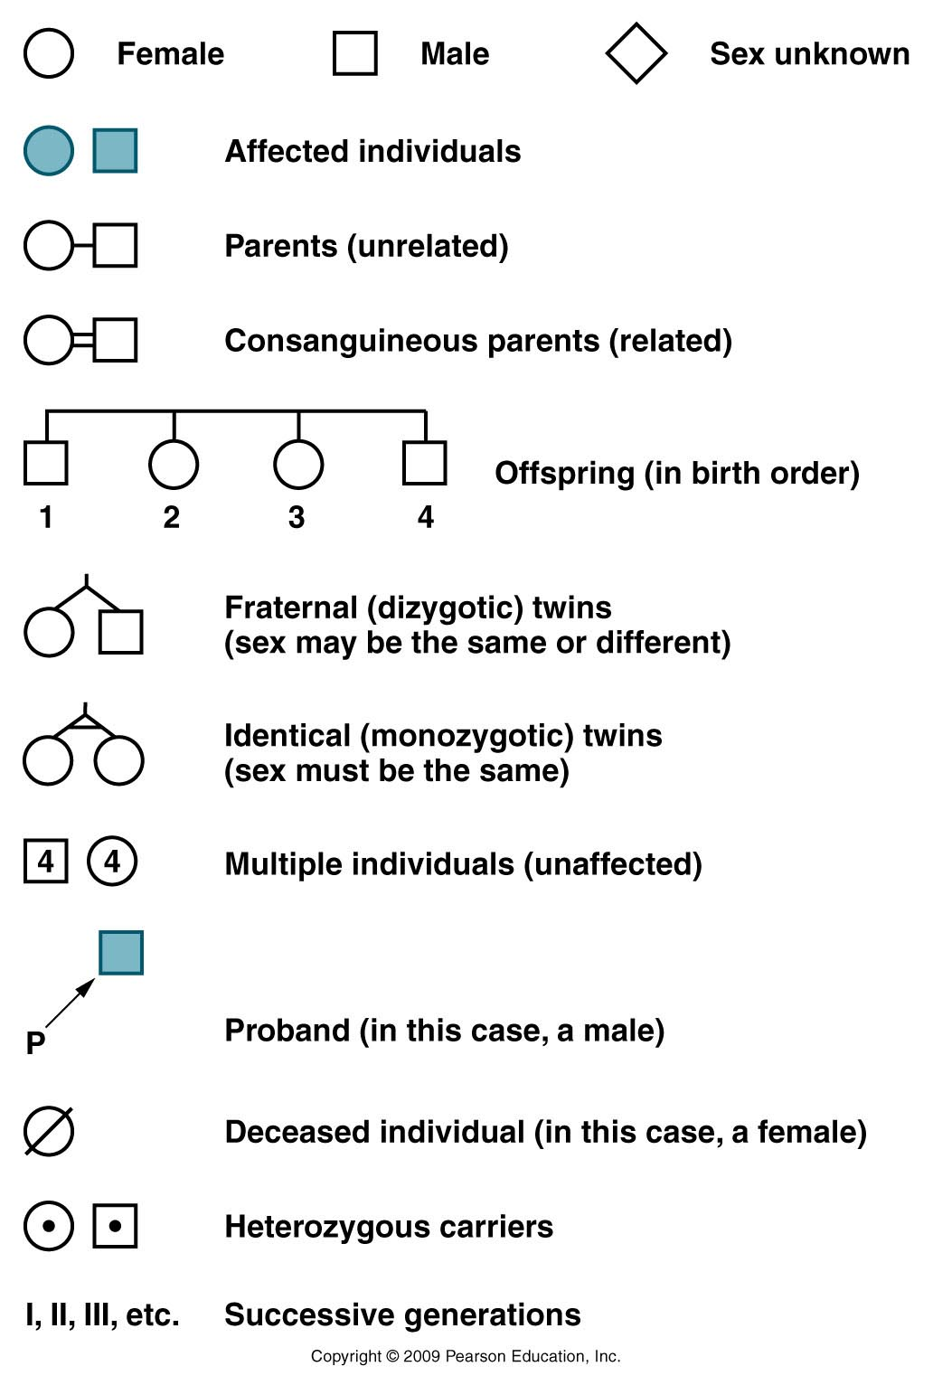
Pedigree conventions (ways of doing things)
(people who show the trait we
are following)
(the person whose condition initiated the study of the family)
P=“proband”
Usually not shown—can be inferred
Figure 3.13
Notes:
Figure 3-13 Conventions commonly encountered in human pedigrees.

Slide 32
Analysis of pedigrees usually answers 2 questions…
Based on the pattern, what is the most likely mode of inheritance of this trait?
recessive trait
dominant trait
seems not to follow Mendelian patterns
Not a genetic trait at all
Shows an extension of Medelian inheritance

Slide 33
2. If the trait shows a genetic pattern, what are the most likely genotypes for the individuals?

Slide 34
Some general pointers for pedigree analysis…
Practice! Draw out possibilities and see if they make sense! Assign a mode of inheritance. Do all individuals fit within this mode?
Remember, these are not Mendel’s crosses—parents are not necessarily “true-breeding”
Predict probabilities for outcomes.
Remember some alleles can be considered rare or common in the population.
Life is not a Punnett square.

Slide 35
Practice!
Does the affected individual appear to have a dominant or a recessive trait? (assuming the trait is genetic).

Slide 36
Practice!
My guess---This shows the characteristics of a recessive trait.
If true, the parents are heterozygotes who don’t show the trait.
The affected child is homozygous recessive.
The unaffected children are heterozygotes or homozygous dominant

Slide 37
Try applying genotypes---If anything is impossible, your guess is wrong!
Aa
Aa
Shows the characteristics of a recessive trait.
If true, the parents are heterozygotes.
The affected child is homozygous recessive.
The unaffected children are heterozygotes or homozygous dominant
A__
A__
aa
A__
It’s extremely important to realize in real life, in families,
traits do not have to show theoretical frequencies (even though this example
does show a 25% frequency) RECALL THE SCHWANDT FAMILY!!

Slide 38
What if we had decided it is a dominant trait…?
What do we know for sure to start?

Slide 39
What if we had decided it is a dominant trait…?
What do we know for sure to start?
A__

Slide 40
What if we had decided it is a dominant trait…?
A__
This child would have had to inherit a dominant allele from Mom or Dad----If Mom or Dad had a dominant allele for this trait they would also express this trait. The pedigree shows them as unaffected---so the guess of dominant for this trait is inconsistent with its pattern of inheritance.

Slide 41
Try this one!
It could be either dominant or recessive---draw it out and show (separately) genotypes consistent with either.
Important!!!! A trait cannot be both dominant AND recessive—We would have to look at more individuals and generations to know for sure.

